Slide 1
Investigating the Evolution of SARS-CoV-2 through Codon Bias Analysis
APRIL BATTS
AMBER GINN
MARY HUBLEY
JENNA GREEN
KUTLUHAN INCEKARA
HOFF LINDBERG

Slide 2
Background
Investigate the evolution of the Wuhan-Hu-1 strain of SARS-CoV-2 and discern whether it may have undergone rapid evolution through cross-strain hybridization or perhaps laboratory engineering.
In December 2019, a coronavirus began spreading among humans in Wuhan, China which has led to the current global pandemic fueled by the virus named “severe acute respiratory syndrome coronavirus 2” (SARS-CoV-2) (Singh & Yi, 2021).
Understanding the continuous evolution of SARS-CoV-2 will provide information on how to control disease transmission as well as prevent future outbreaks.
Our group will assess this evolution by analyzing codon usage distribution, a proven method for differentiating viral strains.

Slide 3
Goals
Examine the codon usage distribution throughout the Wuhan-Hu-1 strain of SARS-CoV-2 in order to assess whether the Wuhan-Hu-1 strain of SARS-CoV-2 may have undergone rapid evolution. This will involve determining the codon frequencies throughout the Wuhan-Hu-1 genome and comparing these frequencies within the genome as well as with the genomes of other known coronaviruses. The genetic code consists of 64 codons which translate into 20 amino acids; therefore, multiple codons encode for the same amino acid (NatureEducation, 2014). A particular virus often uses some redundant codons more frequently than others. This frequency found in the genome of an organism is referred to as codon usage bias.
Create a coding program in Python to display distribution tables of codons from the sequence of the genome in regions of arbitrary size.
Find non-highest-frequency codons within the genome and see if these are clustered in regions as well as regions with significantly different codon bias than the rest of the genome.
Create plots of canonical versus non-canonical codon bias all from the Wuhan-Hu-1 genome.
Generate data for the Wuhan-Hu-1 genome and compare that with a long-standing non-human-pathogenic strain(s), and then with other closely related human-pathogenic coronaviruses. As our project evolves and the initial data analysis progresses, we may develop other objectives to explore.

Slide 4
Tools and Resources
GenBank (https://www.ncbi.nlm.nih.gov/genbank/)
GISAID (https://www.gisaid.org/)
GitHub (https://github.com/mbhubley/BIOT670_COVIDAnalysisProject)
Python
R

Slide 5
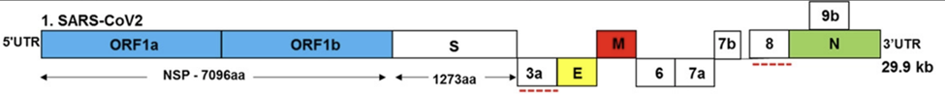
Assumptions and Special Considerations
Currently, SARS-CoV-2 has a relatively low codon usage bias as seen in the literature (Hou, 2020; Dilucca, et al., 2020).
Further, this virus has been extensively studied and a link to the virus being human engineered has not been established (Andersen et al., 2020).
The most prevalent strain is in a constant state of mutation and adaptation and the scope of this project could go in perpetuity (De Maio et al., 2021).
Strains that will be analyzed through our pipeline must be identified, isolated and sequenced first so that we may identify the codon frequencies
Graphical representation of SARS-CoV-2 genome. Adapted from “SARS-CoV-2, the pandemic coronavirus: Molecular and structural insights,” by S.B. Kadam, G.S. Sukhramani, P. Bishnoi, A.A. Pable, & V.T. Barvkar, 2021, Journal of Basic Microbiology, 63(3), 180-202

Slide 6
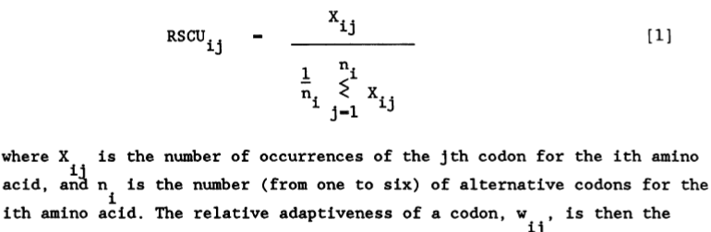
Calculating Codon Usage Bias
Sharp & Li (1987) described method to calculate the relative synonymous codon usage (RSCU) for each amino acid.
The codon adaptive index (CAI) is then calculated using the RSCU values from a reference set of highly expressed genes to represent optimal usage. When calculating CAI values for viral genes, the reference set of RSCU values is derived from the host.
Since calculated with host RSCU values, CAI values are useful in comparing how well SARS-CoV-2 is adapted to the host; not necessarily indicated for direct comparison with other viruses.

Slide 7
Calculating Codon Usage Bias
Wright (1990) described a method for calculating the effective number of codons (ENC) value, another index for determining codon usage bias.
ENC reflects the degree with which a gene’s codon usage deviates from equal usage with a score from 20 (highly biased) to 61 (no bias).
Weaknesses with this metric have been identified and several alternative methods for calculation have been proposed since first introduction in 1990 (Fuglsang, 2004; Banerjee, Gupta, & Ghosh, T.C., 2005; Fuglsang, 2006; Sun, Yang, & Xia, 2013).
At this time, we are proceeding with calculating RSCU values in our python code.

Slide 8
Building out the Python Pipeline-from scratch!
hhttps://github.com/mbhubley/BIOT670_COVIDAnalysisProject/pull/5/commits/1200d53156cdc347ae4c2517af0061db98b80cb3
# =============================================================================
# Group 2 COVID Analysis Project
# BIOT 670, Spring 2022
# University of Maryland Global Campus
# =============================================================================
# Please refer for calculations:
# Sharp, P. M., & Li, W.-H. (1987). Nucleic Acids Research, 15(3), 1281–1295.
# https://doi.org/10.1093/nar/15.3.1281
# =============================================================================
# Imports
# =============================================================================
from Bio import SeqIO
from Bio.Seq import Seq
from math import exp, log
import pandas as pd
# =============================================================================
# Define amino acids for each codon
gencode = {
'ATA':'I', 'ATC':'I', 'ATT':'I', 'ATG':'M',
'ACA':'T', 'ACC':'T', 'ACG':'T', 'ACT':'T',
'AAC':'N', 'AAT':'N', 'AAA':'K', 'AAG':'K',
'AGC':'S', 'AGT':'S', 'AGA':'R', 'AGG':'R',
'CTA':'L', 'CTC':'L', 'CTG':'L', 'CTT':'L',
'CCA':'P', 'CCC':'P', 'CCG':'P', 'CCT':'P',
'CAC':'H', 'CAT':'H', 'CAA':'Q', 'CAG':'Q',
'CGA':'R', 'CGC':'R', 'CGG':'R', 'CGT':'R',
'GTA':'V', 'GTC':'V', 'GTG':'V', 'GTT':'V',
'GCA':'A', 'GCC':'A', 'GCG':'A', 'GCT':'A',
'GAC':'D', 'GAT':'D', 'GAA':'E', 'GAG':'E',
'GGA':'G', 'GGC':'G', 'GGG':'G', 'GGT':'G',
'TCA':'S', 'TCC':'S', 'TCG':'S', 'TCT':'S',
'TTC':'F', 'TTT':'F', 'TTA':'L', 'TTG':'L',
'TAC':'Y', 'TAT':'Y', 'TAA':'_', 'TAG':'_',
'TGC':'C', 'TGT':'C', 'TGA':'_', 'TGG':'W'}
# Define synonymous_codons
synonymous_codons = {
"C": ["TGT", "TGC"],
"D": ["GAT", "GAC"],
"S": ["TCT", "TCG", "TCA", "TCC", "AGC", "AGT"],
"Q": ["CAA", "CAG"],
"M": ["ATG"],
"N": ["AAC", "AAT"],
"P": ["CCT", "CCG", "CCA", "CCC"],
"K": ["AAG", "AAA"],
"_": ["TAG", "TGA", "TAA"],
"T": ["ACC", "ACA", "ACG", "ACT"],
"F": ["TTT", "TTC"],
"A": ["GCA", "GCC", "GCG", "GCT"],
"G": ["GGT", "GGG", "GGA", "GGC"],
"I": ["ATC", "ATA", "ATT"],
"L": ["TTA", "TTG", "CTC", "CTT", "CTG", "CTA"],
"H": ["CAT", "CAC"],
"R": ["CGA", "CGC", "CGG", "CGT", "AGG", "AGA"],
"W": ["TGG"],
"V": ["GTA", "GTC", "GTG", "GTT"],
"E": ["GAG", "GAA"],
"Y": ["TAT", "TAC"]}
def gb_parser(file):
# Return biopython genbank record from a genbank formatted file
gb_record = SeqIO.read(open(file,"r"), "genbank")
return gb_record
def in_locs(gene_locs, test):
# Determine if a locus (test) falls within a set of gene loci
found = False
for i in gene_locs:
if test in i:
found = True
return found
def genes(gb_record):
# From a genbank record, return a list of all CDS names, loci, and sequences
names = []
locs = []
seqs = []
for feature in gb_record.features:
# Extract gene names, loci, and sequences from gb record
if feature.type == "CDS":
try:
name = feature.qualifiers.get("gene")[0]
except TypeError:
# If gb record does not include gene names, use product name
name = feature.qualifiers.get("product")[0]
if name in names:
# Avoid duplicate entries
continue
if (in_locs(locs, feature.location.start) == True and in_locs(locs,
feature.location.end) == True):
# Avoid duplicating sequences (i.e. ORF1a & ORF1ab)
continue
names.append(name)
locs.append(feature.location)
seqs.append(feature.location.extract(gb_record).seq)
# Assemble list of lists containing all names, loci, and sequences
genes_all = [names, locs, seqs]
return genes_all
def cds_codons(cds_list):
# Accept a list of CDS sequences and return as a list of codons
cds_codons = []
for cds in cds_list:
for i in range(0,len(cds),3):
cds_codons.append(cds[i:i+3])
return cds_codons
def cds_divide(cds_codons, x):
# Accept a list of codons, return as a list of sequence fragments of x length
cds_fragments = []
i=0
# Split input list of codons into lists of x codons each
while i < len(cds_codons):
cds_fragments.append(cds_codons[i:i + x])
i += x
# Join codons into sequences
for f in range(0,(len(cds_fragments))):
cds_fragments[f] = Seq("").join(cds_fragments[f])
return cds_fragments
def codon_count(seq):
# Accept a sequence and return codon counts as a dictionary
codon_dict = {
"TTT": 0, "TTC": 0, "TTA": 0, "TTG": 0,
"CTT": 0, "CTC": 0, "CTA": 0, "CTG": 0,
"ATT": 0, "ATC": 0, "ATA": 0, "ATG": 0,
"GTT": 0, "GTC": 0, "GTA": 0, "GTG": 0,
"TAT": 0, "TAC": 0, "TAA": 0, "TAG": 0,
"CAT": 0, "CAC": 0, "CAA": 0, "CAG": 0,
"AAT": 0, "AAC": 0, "AAA": 0, "AAG": 0,
"GAT": 0, "GAC": 0, "GAA": 0, "GAG": 0,
"TCT": 0, "TCC": 0, "TCA": 0, "TCG": 0,
"CCT": 0, "CCC": 0, "CCA": 0, "CCG": 0,
"ACT": 0, "ACC": 0, "ACA": 0, "ACG": 0,
"GCT": 0, "GCC": 0, "GCA": 0, "GCG": 0,
"TGT": 0, "TGC": 0, "TGA": 0, "TGG": 0,

Slide 9
Python Code Continued
"CGT": 0, "CGC": 0, "CGA": 0, "CGG": 0,
"AGT": 0, "AGC": 0, "AGA": 0, "AGG": 0,
"GGT": 0, "GGC": 0, "GGA": 0, "GGG": 0}
for i in range(0,len(seq),3):
codon_dict[seq[i:i+3]] += 1
return codon_dict
def codon_aafreq(codon_counts):
# Calculate codon frequencies per amino acid from dictionary of codon counts
codon_aafreq = {
"TTT": 0, "TTC": 0, "TTA": 0, "TTG": 0,
"CTT": 0, "CTC": 0, "CTA": 0, "CTG": 0,
"ATT": 0, "ATC": 0, "ATA": 0, "ATG": 0,
"GTT": 0, "GTC": 0, "GTA": 0, "GTG": 0,
"TAT": 0, "TAC": 0, "TAA": 0, "TAG": 0,
"CAT": 0, "CAC": 0, "CAA": 0, "CAG": 0,
"AAT": 0, "AAC": 0, "AAA": 0, "AAG": 0,
"GAT": 0, "GAC": 0, "GAA": 0, "GAG": 0,
"TCT": 0, "TCC": 0, "TCA": 0, "TCG": 0,
"CCT": 0, "CCC": 0, "CCA": 0, "CCG": 0,
"ACT": 0, "ACC": 0, "ACA": 0, "ACG": 0,
"GCT": 0, "GCC": 0, "GCA": 0, "GCG": 0,
"TGT": 0, "TGC": 0, "TGA": 0, "TGG": 0,
"CGT": 0, "CGC": 0, "CGA": 0, "CGG": 0,
"AGT": 0, "AGC": 0, "AGA": 0, "AGG": 0,
"GGT": 0, "GGC": 0, "GGA": 0, "GGG": 0}
for codon in codon_counts:
# Find total counts for all synonymous codons
sumni = 0
for aa in synonymous_codons:
if codon in synonymous_codons[aa]:
for i in synonymous_codons[aa]:
sumni += codon_counts[i]
# Calculate frequency for each synonymous codon
if sumni > 0:
codon_aafreq[codon] = codon_counts[codon] / sumni
else:
# Avoid divide by zero error
codon_aafreq[codon] = 0
return codon_aafreq
def get_RSCU(codon_freq):
# Calculate RSCU values from a dictionary of codon frequencies
rscu = {}
for val in synonymous_codons.values():
# Calculate expected frequency if equal usage among synonymous codons
exp_freq = 1/len(val)
# Calculate rscu (observed/expected)
for i in val:
rscu[i] = codon_freq[i]/exp_freq
return rscu
def codon_to_num(codon_dict):
# Accept a dictionary with codons as keys and convert codons to numbers
# Define numerical values for codons
codon_num = {
'ATA':1, 'ATC':2, 'ATT':3, 'ATG':4,
'ACA':5, 'ACC':6, 'ACG':7, 'ACT':8,
'AAC':9, 'AAT':10, 'AAA':11, 'AAG':12,
'AGC':13, 'AGT':14, 'AGA':15, 'AGG':16,
'CTA':17, 'CTC':18, 'CTG':19, 'CTT':20,
'CCA':21, 'CCC':22, 'CCG':23, 'CCT':24,
'CAC':25, 'CAT':26, 'CAA':27, 'CAG':28,
'CGA':29, 'CGC':30, 'CGG':31, 'CGT':32,
'GTA':33, 'GTC':34, 'GTG':35, 'GTT':36,
'GCA':37, 'GCC':38, 'GCG':39, 'GCT':40,
'GAC':41, 'GAT':42, 'GAA':43, 'GAG':44,
'GGA':45, 'GGC':46, 'GGG':47, 'GGT':48,
'TCA':49, 'TCC':50, 'TCG':51, 'TCT':52,
'TTC':53, 'TTT':54, 'TTA':55, 'TTG':56,
'TAC':57, 'TAT':58, 'TAA':59, 'TAG':60,
'TGC':61, 'TGT':62, 'TGA':63, 'TGG':64}
num_dict = {}
for key in codon_dict.keys():
num_dict[codon_num[key]] = codon_dict[key]
return num_dict
def file_writer(any_dict, name):
# Write dictionary items into a file
with open(name + ".csv","w") as f:
for key, val in any_dict.items():
f.write(str(key) + "," + str(round(val,3)) + "\n")
print(name + ".csv is written!")
def file_writer2(sample_frags, name):
# Write multiple dictionary items into the same file
key_list=[]
freq_list=[]
for key, val in sample_frags.items():
key_list.append(key) #alternate 1
freq_list.append(val)
df = pd.DataFrame(freq_list, index=key_list)
df.to_csv(name + ".csv", sep=",")
print (name + ".csv is written!")
# =============================================================================
def main():
# From a gb file, calculate RSCU for whole genome and for each gene, output to
# csv. Option to also use fragments of arbitrary size (commented out).
# Get genome sequence from gb file
file_name = input("Please enter your GB filename: ")
# Parse genbank file
sample_gb_record = gb_parser(file_name)
sample_genes = genes(sample_gb_record)
sample_codons = cds_codons(sample_genes[2])
# Analyze whole genome
counts_genome = codon_count(Seq("").join(sample_genes[2]))
freq_genome = codon_aafreq(counts_genome)
rscu_genome = get_RSCU(freq_genome)
# Analyze by gene
freq_genes = {}
rscu_genes = {}
for i in range(0,len(sample_genes[0])):
name = sample_genes[0][i]
count = codon_count(sample_genes[2][i])
freq = codon_aafreq(count)
rscu = get_RSCU(freq)
freq_genes[name] = freq
rscu_genes[name] = rscu
## # Analyze by fragments of any number of codons
## frag_number = int(input("To divide genome into regions of arbitrary size, "
## "enter the desired number of codons per region: "))
## # Divide genome into fragments and calculate RSCU
## sample_fragments = cds_divide(sample_codons, frag_number)
## freq_frags = {}
## rscu_frags = {}
## pos = 1
## for i in range(0,len(sample_fragments)):
## count = codon_count(sample_fragments[i])
## freq = codon_aafreq(count)
## rscu = get_RSCU(freq)
## freq_frags[str(pos)+"-"+str(pos+frag_number-1)] = freq
## rscu_frags[str(pos)+"-"+str(pos+frag_number-1)] = rscu
## pos += frag_number
# Option to convert codons to numbers
convert = input("Convert codons to numeric values? Enter Y/N: ")
if convert.lower() == "y":
rscu_genome = codon_to_num(rscu_genome)
for key in rscu_genes.keys():
rscu_genes[key] = codon_to_num(rscu_genes[key])
## for key in rscu_frags.keys():
## rscu_frags[key] = codon_to_num(rscu_frags[key])
# Write genome rscu table to csv file
file_writer(rscu_genome, file_name + "_rscu_genome")
# Write gene rscu table to csv file
file_writer2(rscu_genes, file_name + "_rscu_genes")
## # Write fragment rscu table to csv file
## file_writer2(rscu_frags, file_name + "_rscu_frags")
# =============================================================================
if __name__ == "__main__":
main()

Slide 10
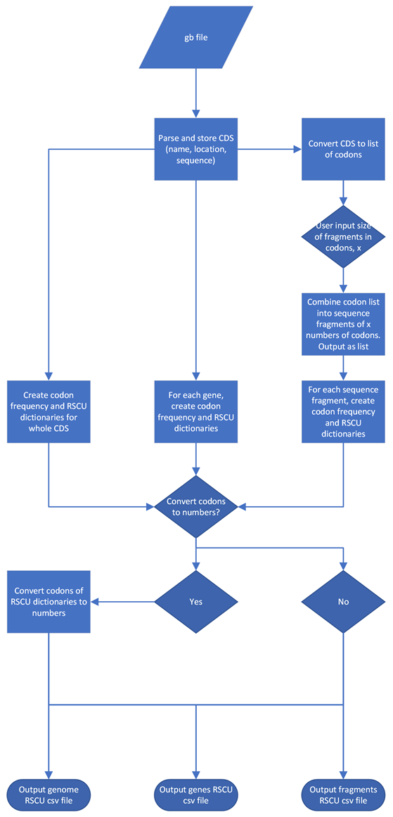
Flowchart depicts the python script to calculate RSCU for the whole genome, for each gene, and for fragments of arbitrary size for each input GenBank file. Also includes an option to convert codons to a numeric value.

Slide 11
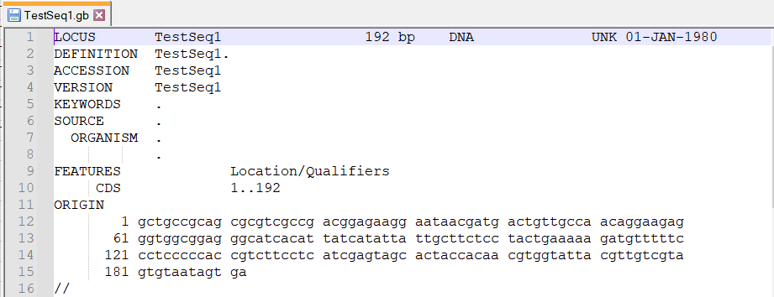
Error Checking and Debugging
Calculated expected codon frequencies assuming equal usage for each synonymous codon in Excel.
Created a gb file of a sequence containing each amino acid exactly once.
The frequencies calculated by our python script for this test sequence should all equal the expected values, since all amino acids have equal usage.
Since RSCU values are equal to observed frequency / expected frequency, RSCU values calculated by our python script should all equal 1.

Slide 12
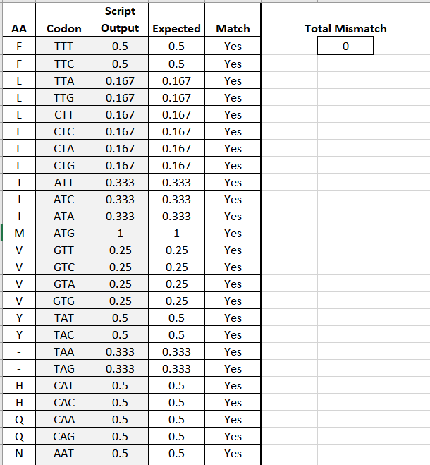
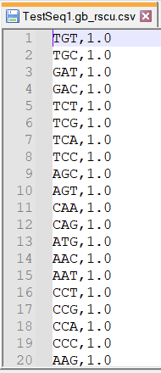
Error Checking and Debugging
After tweaking and debugging, all output values for the test sequence match the expected values.

Slide 13
R Code Used to Visualize Results:
R code for visualization of codon frequencies of different SARS-CoV-2 viral strains:
install.packages("ggplot2")
library(ggplot2)
codon_usage <- read.csv("Wuhan_codon_list.csv")
ggplot(codon_usage, aes(x=Codon, y=Frequency, fill = AA)) +
facet_wrap(~ AA, scale="free_x") + theme_bw()+
geom_bar(stat = "identity")+
ylab("Codon Usage Frequency")+xlab("Codon")+
labs(title = "Wuhan-Hu-1 Codon Frequency Per Amino Acid")+
theme(axis.text.x = element_text(size = 7))+
theme(legend.position="none")
R code for visualization of RSCU values of specific genes and gene fragments for the different SARS-CoV-2 viral strains :
install.packages("ggplot2")
library(ggplot2)
install.packages("tidyr")
library(tidyr)
codon_usage <- read.csv("test1.csv")
ggplot(codon_usage, aes(x=Codon, y=RSCU_Values, fill = Measure))+
geom_bar(stat='identity')+
facet_wrap(~Measure, ncol=1, strip.position = "left")+
theme(axis.text.x = element_text(angle = 90, vjust = 0.5, hjust=1))+
theme(legend.position="none")+
labs(title = "input_graph_title_here")

Slide 14
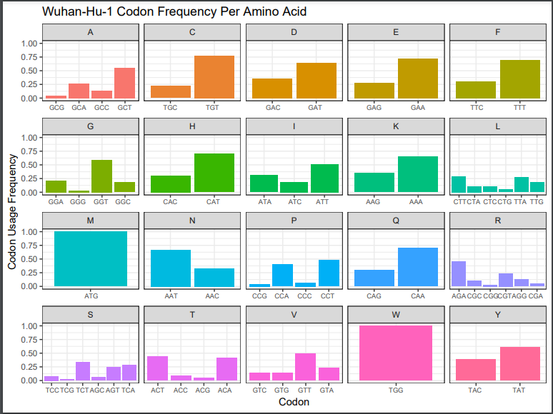
Codon Distribution created from test data and Wuhan strain

Slide 15
Codon Diversity by Strain
Previous analysis will be verified as correct
More strains will be run with R code to compare frequencies by strain
Genome will split into regions to identify those with different codon usage

Slide 16
Other CoVs Considered for Comparison
Non-Human Pathogenic
Human Pathogenic
RaTG13
Host: Horseshoe bat Rhinolophus affinis
Identified in Yunnan Province, China in 2013
High sequence similarity to Wuhan-Hu-1 strain of SARS-CoV-2 (96.2%)
Estimated divergence from SARS-CoV-2 ~30 years ago
Li, Lai, Gao & Shi (2021)
BANAL-52, -103, or -236 strains
Host: bats R. malayanus, R. pusillus, R. marshalli
Identified in Laos 2021
All 3 have regions with higher similarity to SARS-CoV-2 than RaTG13
BANAL-52 has higher overall similarity (96.8%). Currently most closely related CoV identified.
Mallapaty (2021)
SARS-CoV
Most closely related human pathogenic CoV to SARS-CoV-2
Also likely emerged from bat CoVs
Petrosillo, Viceconte, Ergonul, & Peterson (2020)
HCoV OC43
Same genus as SARS-CoV & SARS-CoV-2
Responsible for most human CoV infections pre-pandemic (common cold)
Lau et al. (2011)
Has been suggested as possible cause of 1889-1890 pandemic
Brussow & Brussow (2021).

Slide 17
Results
A more substantial mutational pressure is seen in ORF1a than in ORF1b
Another trend of note is G and C-ended codons should be significantly lower than A and U-ended codons of trends to observe
In the Wuhan-1 reference (SARS-CoV-2) the predominant pattern of A- and T rich codons are seen in the optical codon frequencies.
G and C-ended codons are less as expected. Most of the GC ended codons values were not optimal and will have a negative impact on codon usage bias. (RSCU values <1 are not optimal).
HCov-OC-43 is the outlier strain that has the most abundant/over-expressed codons compared to Wuhan-1, ratg13, and Banal-20-52.
A- and T-ending codons are predominant in the HCov-OC-43 strain with higher frequencies from the overexpressed codons observed.
Very little difference was observed between Wuhan-Hu-1 and other strains of SARS-CoV-2

Slide 18
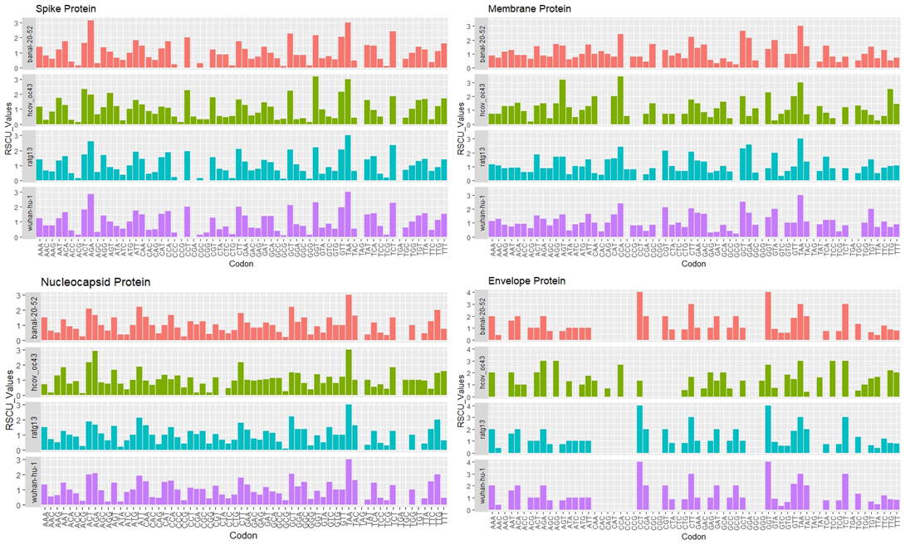
RSCU values for different genes of SARS-CoV-2 viral strains

Slide 19
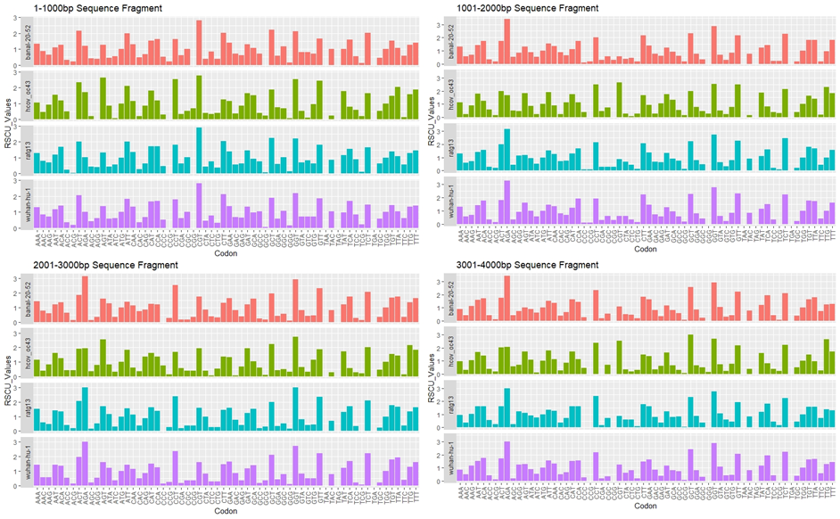
RSCU values for different gene fragments of SARS-CoV-2 viral strains

Slide 20
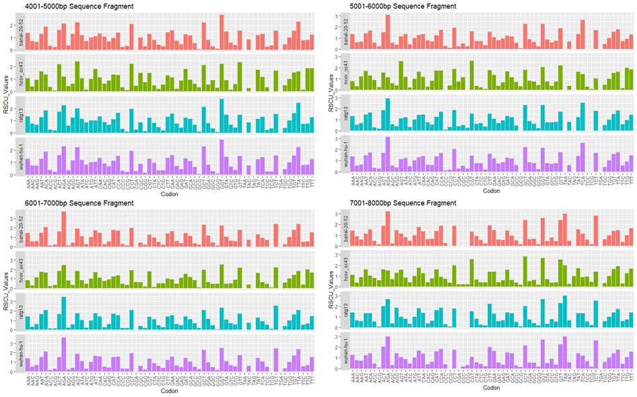
RSCU values for different gene fragments of SARS-CoV-2 viral strains

Slide 21
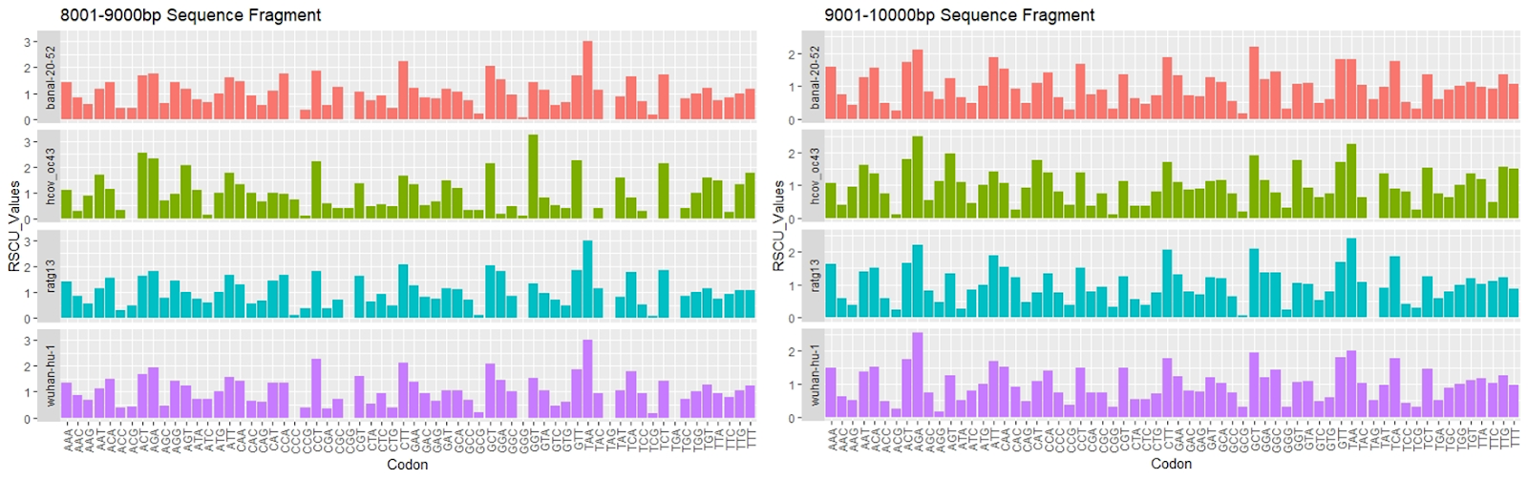
RSCU values for different gene fragments of SARS-CoV-2 viral strains

Slide 22
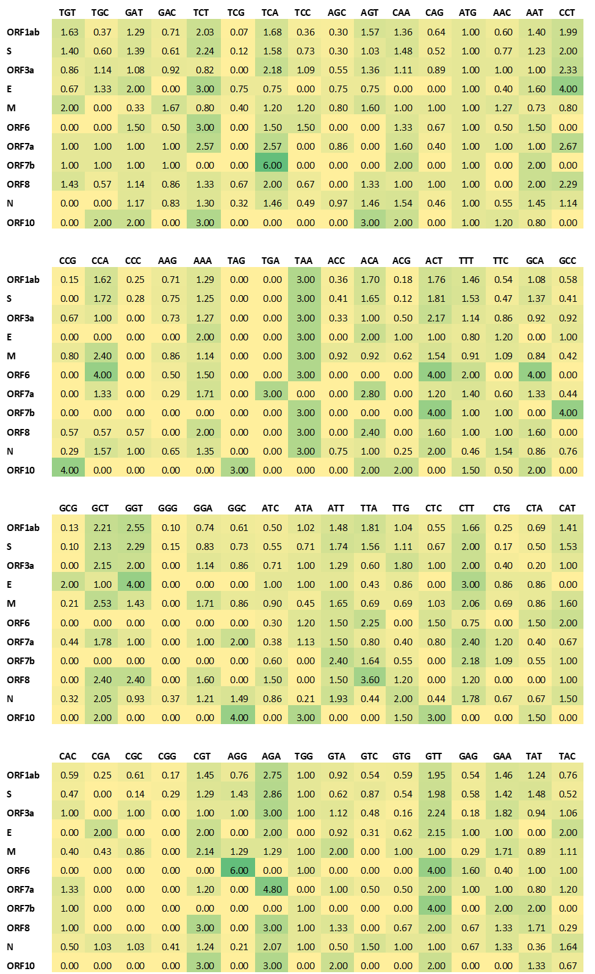
Heatmap of Wuhan-Hu-1 strain RSCU values by genes

Slide 23
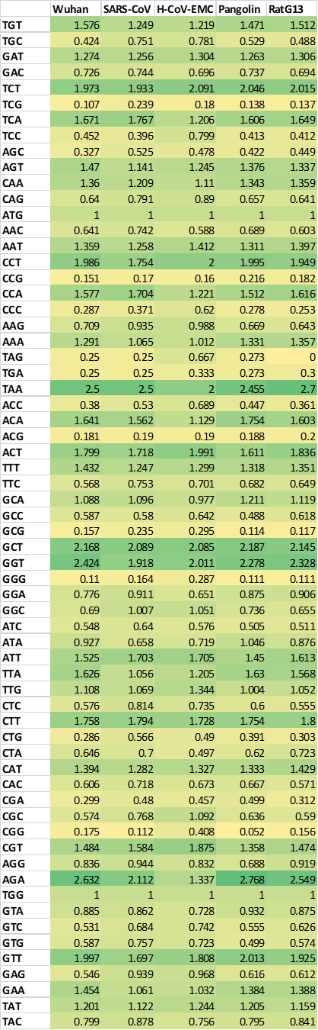
Comparison of SARS, MERS, Pangolin, and Bat coronaviruses RSCU values

Slide 24
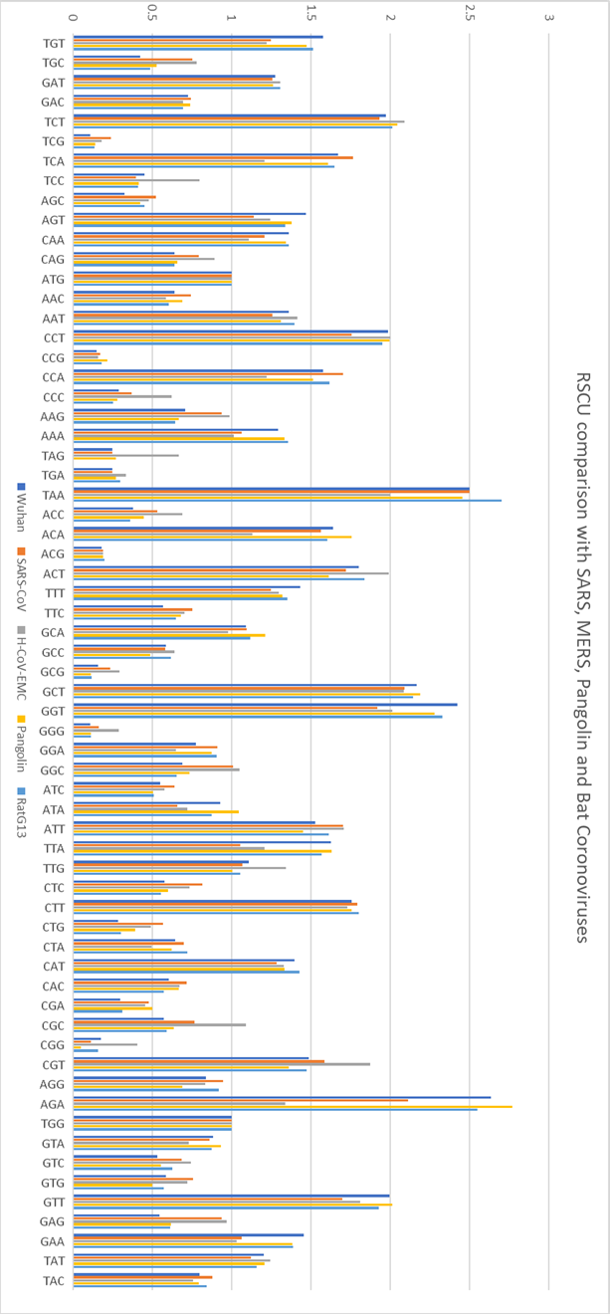
RSCU Comparison with SARS, MERS, Pangolin, and Bat

Slide 25
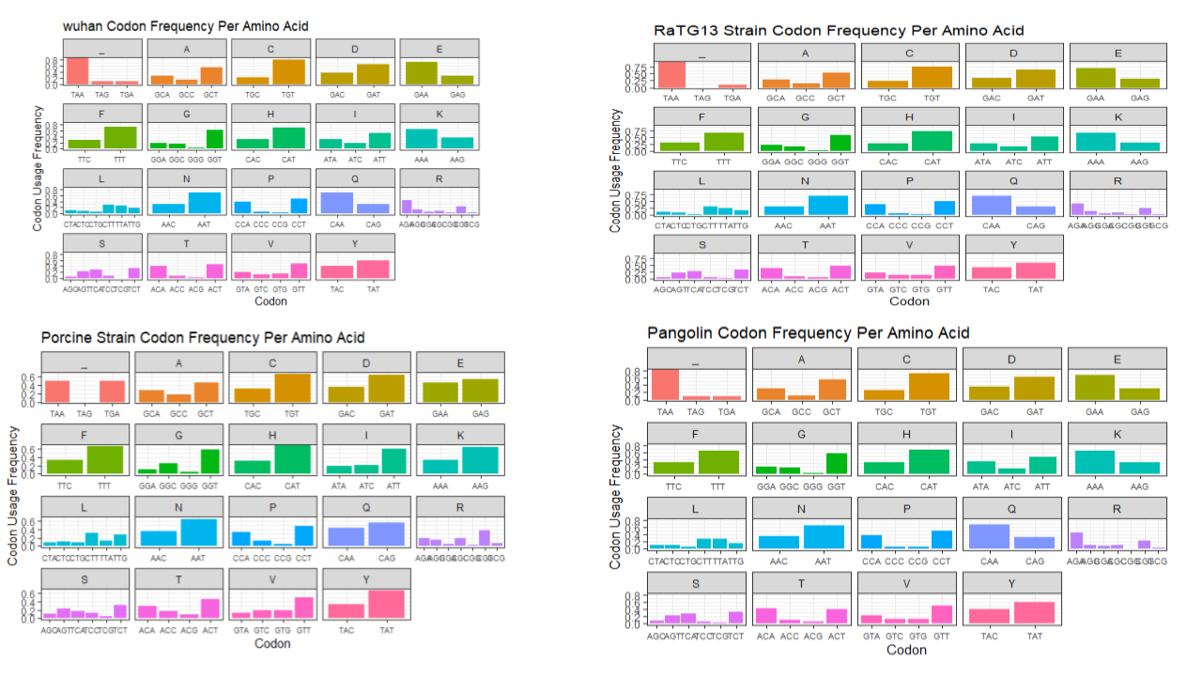
Multiple host codon frequencies comparisons.

Slide 26
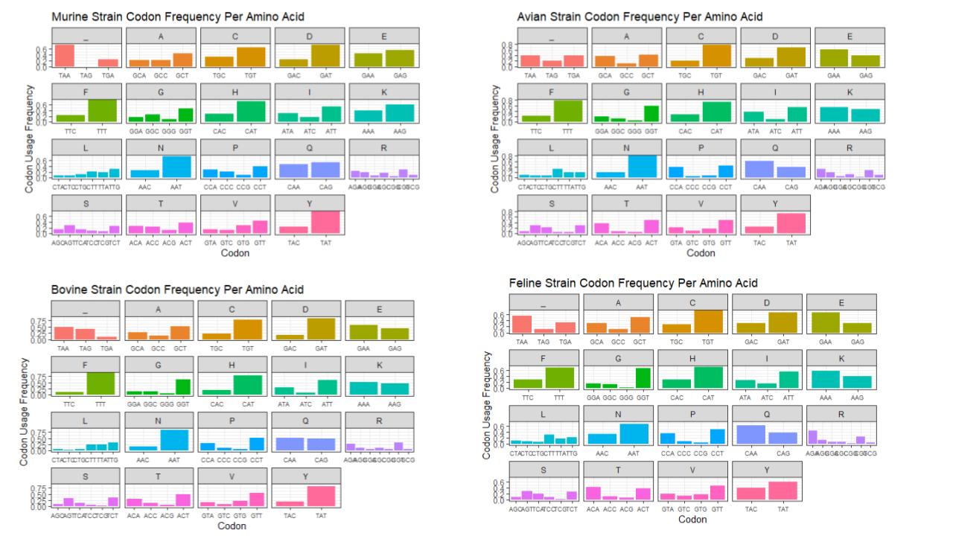
Multiple host codon frequencies comparisons.

Slide 27
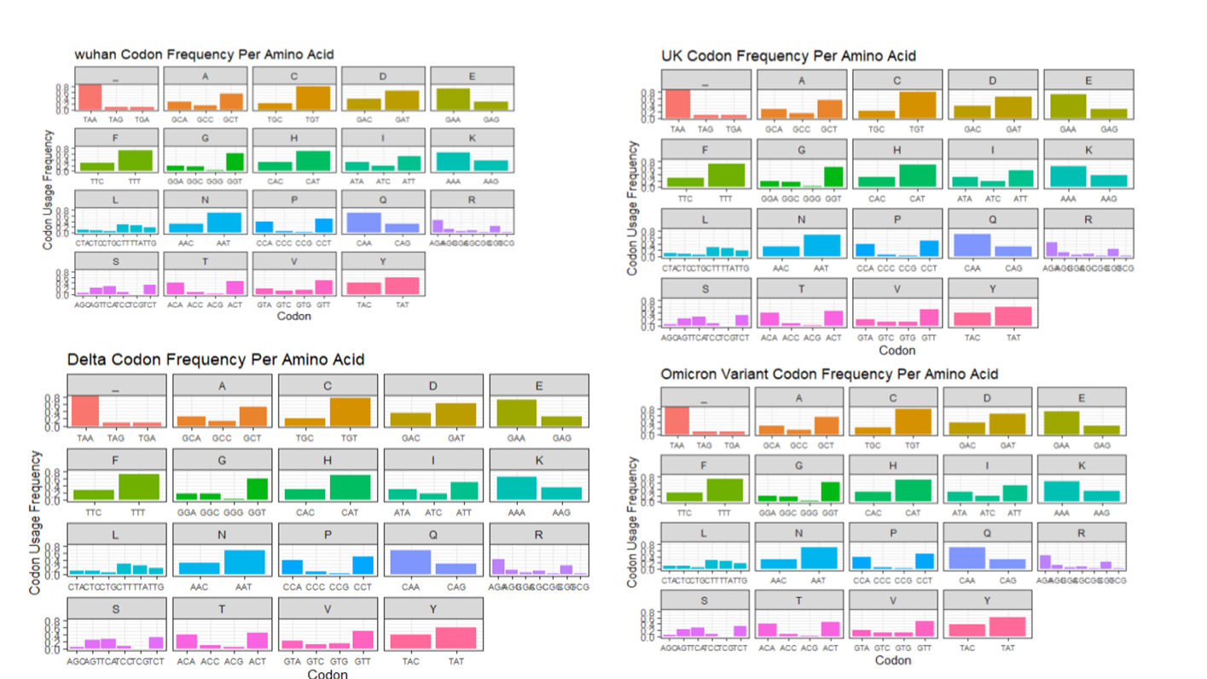
Codon frequencies within the same host (human).

Slide 28
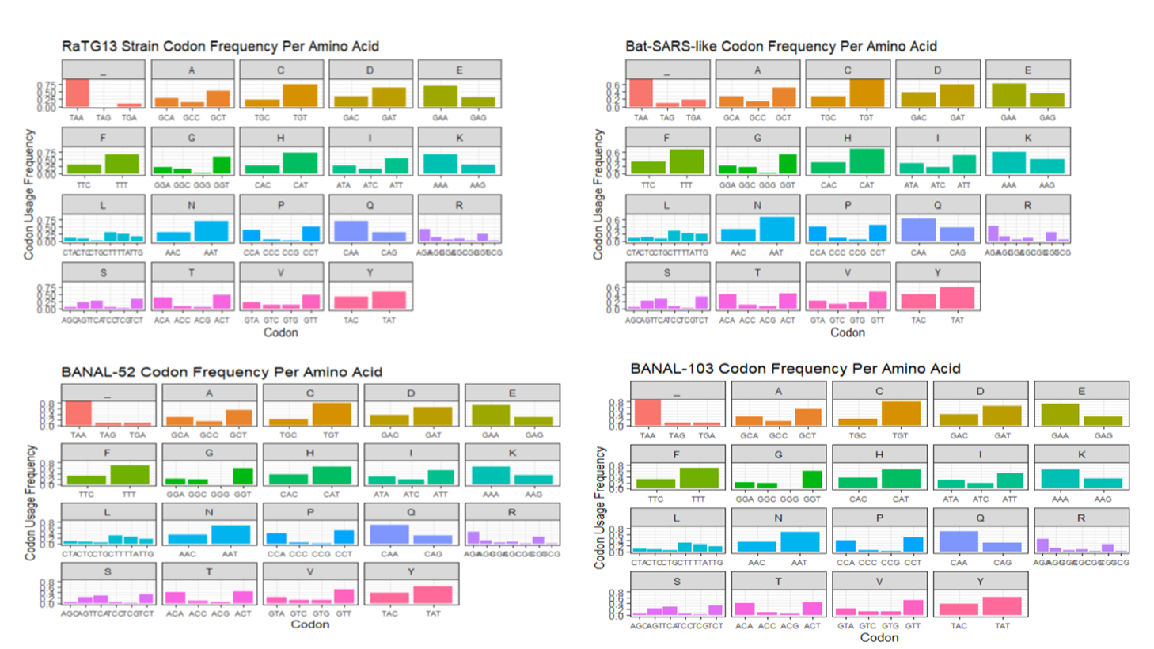
Codon frequencies within the same host (bat).

Slide 29
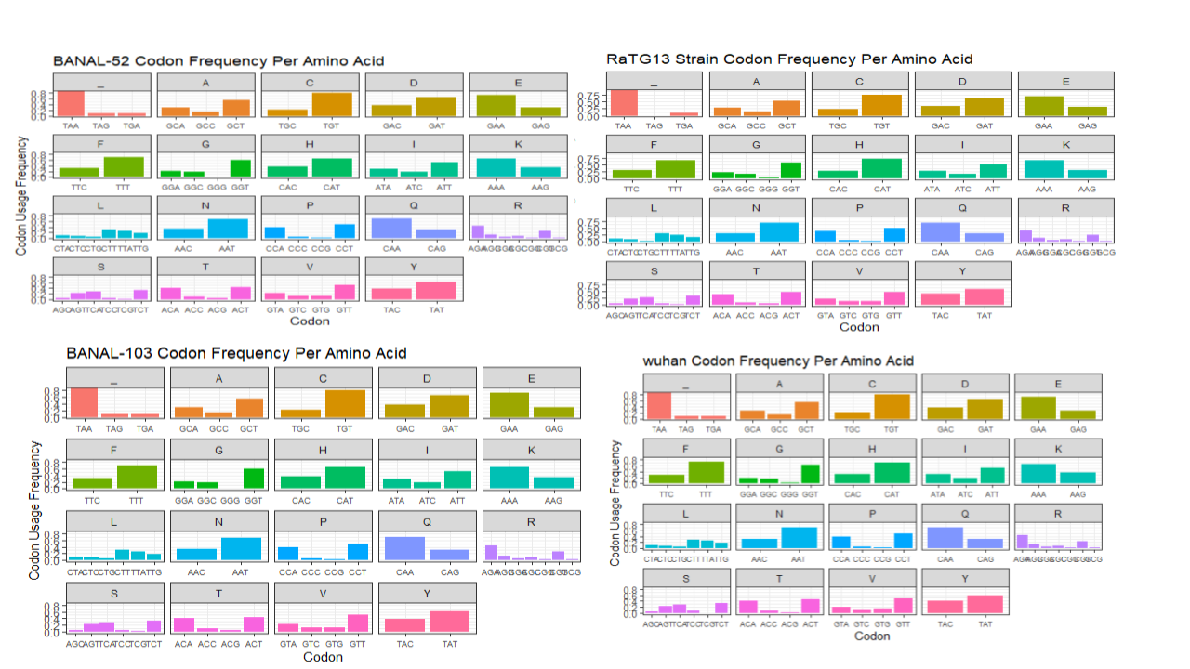
BANAL-52, BANAL-103, RaGT13 and Wuhan-1 codon frequencies comparison.

Slide 30
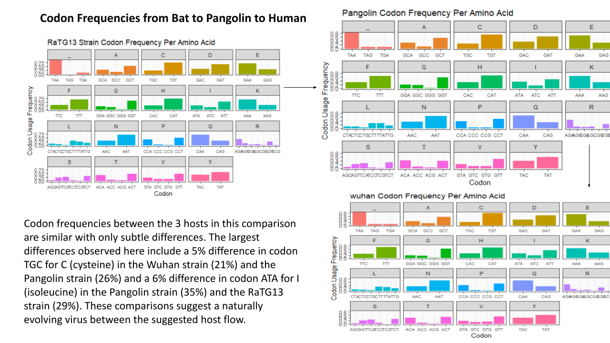
Subtle codon usage differences observed in 3 different hosts showing the suggested host flow of the coronavirus from the historical bat host to the first identified human host strain responsible for the pandemic caused by SARS-CoV-2 infection.

Slide 31
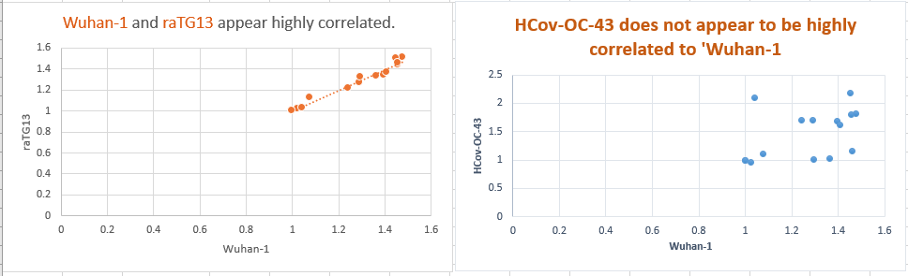
Correlation with Wuhan-1 and both RaTG13 and Human coronavirus OC43

Slide 32
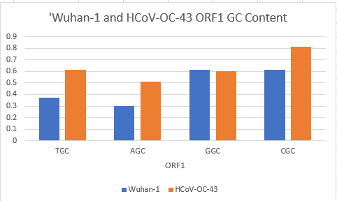
Comparison of GC content between Wuhan-1 and Human coronavirus OC43

Slide 33
Discussion
Codon usage almost the same in strains isolated from the same hosts though differences are observed in strains isolated from different hosts
The future implications of this project are huge, if we can accurately map codon variability in SARS-CoV-2, then we can also begin to make prediction models so that we can be better equipped to tailor new vaccines as the ones we have today become obsolete due to mutation.
Since the code is already written, the possibilities are endless for what kinds of data we could analyze.

Slide 34
REFERENCES
Andersen, K., Rambaut, A., Lipkin, W. et al. (2020) The proximal origin of SARS-CoV-2. Nature Medicine, 26, 450–452. https://doi.org/10.1038/s41591-020-0820-9
Brussow, H., & Brussow, L. (2021). Clinical evidence that the pandemic from 1889 to 1891 commonly called the Russian flu might have been an earlier coronavirus pandemic. Microbial Biotechnology, 14(5). 1860-1870. https://10.1111/1751-7915.13889
Banerjee, T., Gupta, S.K., & Ghosh, T.C. (2005). Towards a resolution on the inherent methodological weakness of the “effective number of codons used by a gene”. Biochemical and Biophysical Research Communications, 330(4). 1015-1018. https://doi.org/10.1016/j.bbrc.2005.02.150
De Maio, N., Walker, C., Turakhia, Y., Lanfear, R., Corbett-Detig, R., Goldman, N. (2021). Mutation Rates and Selection on Synonymous Mutations in SARS-CoV-2. Genome Biology and Evolution, 13(5). https://doi.org/10.1093/gbe/evab087
Dilucca, M., Forcelloni, S. Georgakilas, A.G., Giansanti, A. & Pavlopoulou, A. (2020). Codon usage and phenotypic divergences of SARS-CoV-2 genes. Viruses, 12(15). 498. https://doi.org/10.3390/v12050498
Fuglsang, A. (2004). The ‘effective number of codons’ revisited. Biochemical and Biophysical Research Communications, 317(3). 957-964. https://doi.org/10.1016/j.bbrc.2004.03.138
Fuglsang, A. (2006). Estimating the "Effective Number of Codons": The Wright Way of Determining Codon Homozygosity Leads to Superior Estimates. Genetics, 172(2). 1301-1307. https://doi.org/10.1534/genetics.105.049643
Hou, W. (2020). Characterization of codon usage pattern in SARS-CoV-2. Virology Journal, 17. 138. https://doi.org/10.1186/s12985-020-01395-x
Lau, S.K.P, Lee, P., Tsang, A.K.L, Yip, C.C.Y, Tse, H., Lee, R.A., Lok-Yee, S., Lau, Y.L., et al. (2011). Molecular Epidemiology of Human Coronavirus OC43 Reveals Evolution of Different Genotypes over Time and Recent Emergence of a Novel Genotype due to Natural Recombination. Journal of Virology, 85(21). 11325-11337. https://doi.org/10.1128/JVI.05512-11
Li, J., Lai, S., Gao, G.F., & Shi, W. (2021). The emergence, genomic diversity and global spread of SARS-CoV-2. Nature, 600. 408-418. https://doi.org/10.1038/s41586-021-04188-6
Mallapaty, S. (2021). Closest known relatives of virus behind COVID-19 found in Laos. Nature, 597. 603. https://doi.org/10.1038/d41586-021-02596-2
NatureEducation. (2014). Genetic Code. Scitable. https://www.nature.com/scitable/definition/genetic-code-13/
Petrosillo, N., Viceconte, G., Ergonul, O., Ippolito, G. & Petersen, E. (2020). COVID-19, SARS and MERS: are they related? Clinical Microbiology and Infection, 26(6). 729-734. https://doi.org/10.1016/j.cmi.2020.03.026
Sharp, P.M. & Li, W-H. (1987). The codon adaptation index – a measure of directional synonymous codon usage bias, and its potential applications. Nucleic Acids Research, 15(3). 1281-1295. https://doi.org/10.1093/nar/15.3.1281
Singh, D. & Yi, S.V. (2021). On the origin and evolution of SARS-CoV-2. Experimental & Molecular Medicine, 53, 537–547. https://doi.org/10.1038/s12276-021-00604-z7
Sun, X., Yang, Q., Xia, X. (2013). An Improved Implementation of Effective Number of Codons (N_{c}). Molecular Biology and Evolution, 30(1). 191-196. https://doi.org/10.1093/molbev/mss201
Wright, F. (1990). The ‘effective number of codons’ used in a gene. Gene, 87(1). 23-29. https://doi.org/10.1016/0378-1119(90)90491-9

